Slide 1
DEEP LEARNING (DL)-ENABLED SYSTEM FOR EMOTIONAL BIG DATA
Presented by,
Arun Prasad M
(AIK19CS019)
S7 CSE
Seminar Guide:
Prof. Nisy John Panicker

Slide 2
TABLE OF CONTENTS
1. INTRODUCTION
2. LITERATURE REVIEW
3. EXISTING SYSTEM
4. PROPOSED SYSTEM
5. WORKING
6. CONCLUSION
7. FUTURE SCOPE
8. REFERENCES

Slide 3
INTRODUCTION
Emotion plays an important role in human life and communication. In the daily life, emotion is an inextricable part of the interaction of human beings, which can be observed by the changes in physiological features and behaviors.
Emotion recognition has a great potential to improve our quality of life.
With the development of big data and deep learning, huge amount of data including emotional data is generated in recent years, using deep learning techniques to analyze the emotional big data, machines can learn and understand emotions to meet human needs, because deep learning techniques can learn and track different physiological features on the body.

Slide 4
Deep learning, has become an important topic in pattern recognition, communication sentiment analysis and feature learning.
CNN models with high accuracy are proposed and trained by researchers in different fields such as hand-written digit recognition, object detection, and facial expression recognition (FER).
In recent years, facial emotion detection methods based on convolutional neural network(CNN) has made some breakthrough, and currently, it has been applied in various field of life.
Facial expression is crucial to identify ones feelings. Facial emotions are the nonverbal way of communication. It is troublesome to search out feeling. emotion care system based on automatic facial expression recognition (FER) system working on an Android smartphone facilitate us plenty in such cases.

Slide 5
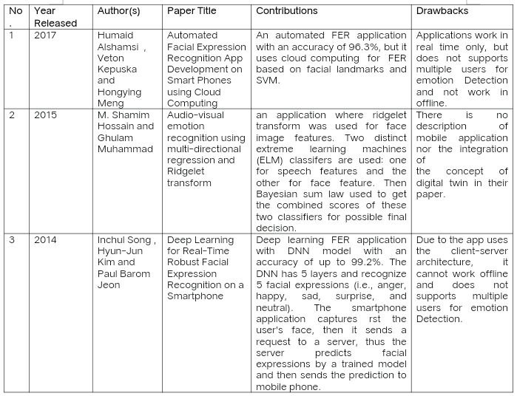
LITERATURE REVIEW MATRIX

Slide 6
EXISTING SYSTEM
1. Real-time mobile facial expression recognition system
System that distinguishes between neutral and non-neutral expression frames in video sequences by using facial landmarks. If non-neutral expression is found, the new dynamic features are generated by displacing saved neutral features with current features. Then the new features are fed into SVM models for FER task.
2. Deep learning for real-time robust facial expression recognition on a smartphone
The smartphone application captures First the user's face, then it sends a request to a server, thus the server predicts facial expressions by a trained model and then sends the prediction to mobile phone. Due to the app uses the client-server architecture, it cannot work offline.

Slide 7
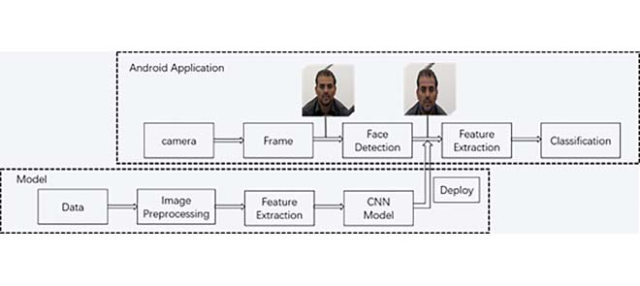
PROPOSED SYSTEM

Slide 8
In this paper, we propose a DT-FER based emotion care system, where emotion is detected in terms of facial expression.
The system contains two parts: model and Android application. In the model part, after image preprocessing for the images from dataset, the deep learning model is trained for emotion classification and deployed on a smartphone.
The DT-FER Android application (app) detects the multiple faces in the images captured from the smartphone camera by using face detector and predicts facial expressions from detected face images by using CNN model in real time and offline.
The application calculates a score for each facial expression and shows the highest score and emotion on the smartphone screen. And the highest score indicates the performed emotion meets the standard better.

Slide 9
The performed facial expression and predicted results can be saved into device to help carers to observe facial expressions of patients at any time and provide better suggestions to patients.
a new dataset for emotion recognition is collected to train the CNN model.
The main contributions of this paper are
1) A new low-cost and multi-user framework for emotion detection is proposed. The system is based on an Android application that uses CNN model to classify facial expressions and works in real time and offline.
2) A new challenging and less-constrained dataset called MCFER is introduced for facial expression classification. The dataset is collected in real scenario with more complex conditions, such as movement and light interference.

Slide 10
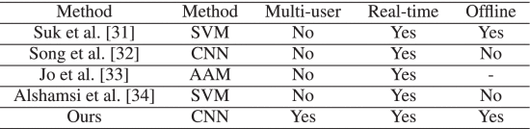
Comparison of existing FER smartphone applications
The existing smartphone applications are compared in Table. While most applications work in real time and offline, none of them supports multiple users for emotion detection. Therefore, we develop a multi-user Android application running in real time and offline for emotion care and autism disorder patient training.

Slide 11
WORKING

Slide 12
DATASET
FER-2013
Facial Expression Recognition 2013 (FER-2013) dataset was prepared in Challenges in Representation Learning: Facial Expression Recognition Challenge. FER-2013 database has seven facial expression categories (e.g., angry, disgust, fear, happy, sad, surprise, and neutral) and three different sets such as training set , validation set , and test set.
CK+
CK+: the Extended Cohn Kanade (CK+) database consists of 593 deliberate image sequences from 123 subjects, which is the most used lab-controlled database for evaluation of FER systems.

Slide 13
MCFER
DATA ACQUISITION:
Data acquisition (commonly abbreviated as DAQ or DAS) is the process of sampling signals that measure real-world physical phenomena and converting them into a digital form that can be manipulated by a computer and software.
DATA DEDUPLICATION:
Haar Cascade is a machine learning-based approach where a lot of positive and negative images are used to train the classifier. Positive images – These images contain the images which we want our classifier to identify. Negative Images – Images of everything else, which do not contain the object we want to detect.

Slide 14
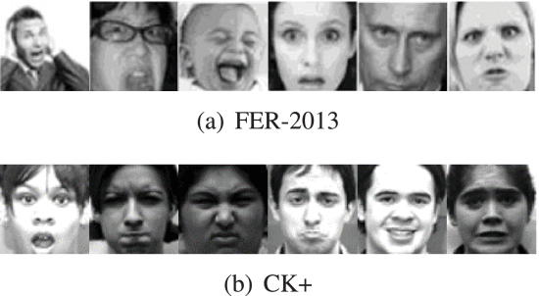
FER – 2013 & CK+

Slide 15
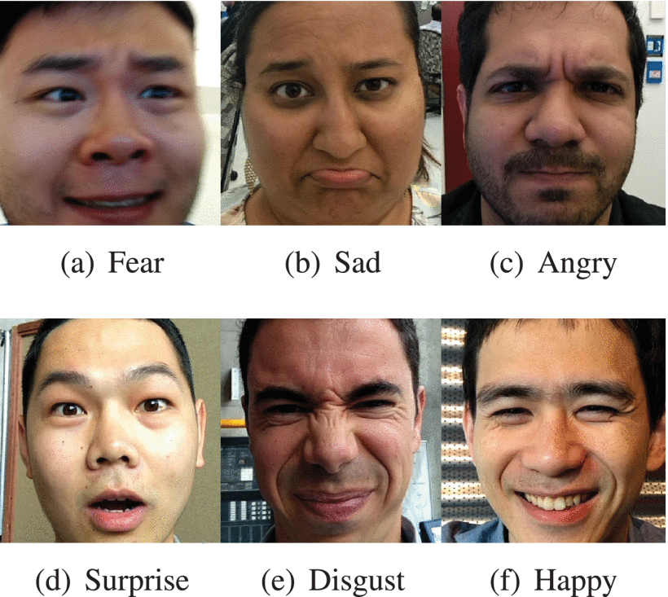
MCFER

Slide 16
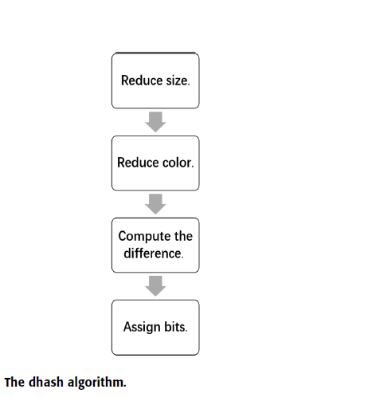
HASH (DHASH) ALGORITHM
We use difference hash (dhash) algorithm to select representative images from the dataset.
The difference hash is one of image Fingerprint algorithms, and it creates a unique hash value by calculating the difference between adjacent pixel values.
To select images form the dataset, we use difference hash to compute our image Fingerprints because of its speed and accuracy.

Slide 17
The image was First shrank to a new size , which would match any similar images regardless of how it is stretched by ignoring the original size and aspect ratio.
Second, the colorful image was converted to grayscale image which reduce hash. Then, the dhash algorithm calculated the difference between adjacent pixels, which identifies the relative gradient direction. Finally, we compared the brightness between Adjacent pixels to get the hash value.
If the left pixel is brighter than the right pixel, the bit is set to 1, otherwise 0.To compare two hashes, we just counted the number of bits that are different which is the Hamming distance.
If the Hamming distance between two images is less than the threshold D, one image would be discarded because we regarded these two images were the “same” images containing repetitive information.

Slide 18
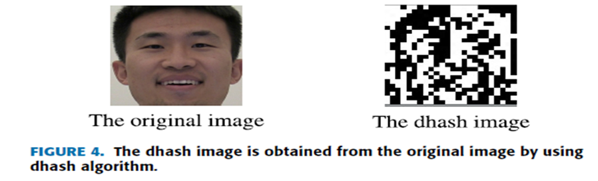

Slide 19
IMAGE PREPROCESSING
The image preprocessing mainly consists of two stages:
Face detection :
A face detector is adopted for face detection in our system. If faces are detected, the four coordinates of region of interest (ROI) of the faces would be returned to the system, the system would crop the faces and discard irrelevant background.
Data augmentation :
Data augmentation is used to process the detected face images and increase the quantity of data, because training process of deep learning model usually needs huge amounts of data.

Slide 20
CNN MODEL
A convolutional neural network (CNN) is a subset of machine learning. It is one of the various types of artificial neural networks which are used for different applications and data types. A CNN is a kind of network architecture for deep learning algorithms and is specifically used for image recognition and tasks that involve the processing of pixel data.

Slide 21
MOBILENET V1
MobileNet V1 is a variant of MobileNet model which is specially designed for edge devices.
MobileNet V1 is an efficient and portable CNN architecture that is used in real world applications. MobileNets primarily use depthwise separable convolutions in place of the standard convolutions used in earlier architectures to build lighter models. MobileNets introduce two new global hyperparameters (width multiplier and resolution multiplier) that allow model developers to trade off latency or accuracy for speed and low size depending on their requirements.

Slide 22
WIDTH MULTIPLIER & RESOLUTION MULTIPLIER
Width multiplier (denoted by α) is a global hyperparameter that is used to construct smaller and less computationally expensive models. Its value lies between 0 and 1.For a given layer and value of α, the number of input channels 'M' becomes α * M and the number of output channels 'N' becomes α * N hence reducing the cost of computation and size of the model at the cost of performance. The computation cost and number of parameters decrease roughly by a factor of α2.Some commonly used values of α are 1,0.75,0.5,0.25.
The second parameter introduced in MobileNets is called resolution multiplier and is denoted by ρ.This hyperparameter is used to decrease the resolution of the input image and this subsequently reduces the input to every layer by the same factor. For a given value of ρ the resolution of the input image becomes 224 * ρ.This reduces the computational cost by a factor of ρ2.

Slide 23
DEPTHWISE SEPERABLE CONVOLUTION
MobileNets are built on depthwise separable convolution layers. Each depthwise separable convolution layer consists of a depthwise convolution and a pointwise convolution. Counting depthwise and pointwise convolutions as separate layers.

Slide 24
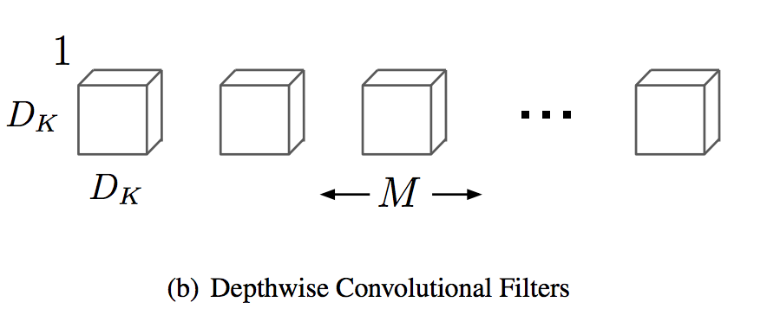
DEPTHWISE CONVOLUTION
Depthwise Convolution is a special case of Group Convolution where number of input channel is same as number of output channels. It reduces the number of floating point operations nearly by a factor of number of channels compared to the standard Convolution approach.

Slide 25
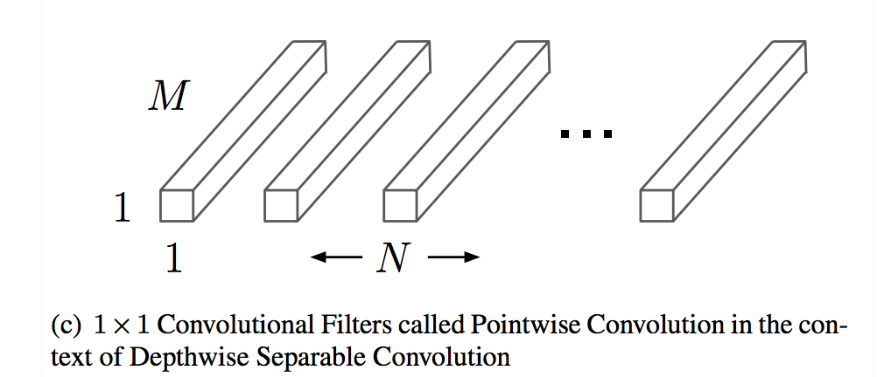
POINTWISE CONVOLUTION
Pointwise Convolution is a form of convolution that employs a 1x1 kernel, which iterates across each and every point. This kernel has a depth equal to the number of channels in the input picture. It may be used with depthwise convolutions to create depthwise-separable convolutions, which are a useful type of convolution.

Slide 26

REDUCTION OF COMPUTATION
Mobilenet V1 architecture has smaller model size and complexity because of fewer number of parameters and fewer additions and multiplications. The reduction of computation between traditional convolution and combination of depthwise and pointwise convolutions are compared in Equation 1. The computation amount of traditional convolution is represented as denominator and the numerator shows the computation amount of MobileNet V1.
Where DK is the convolutional kernel size and DF denotes an input feature map, while M and N denote the number of input and output channels, respectively.

Slide 27
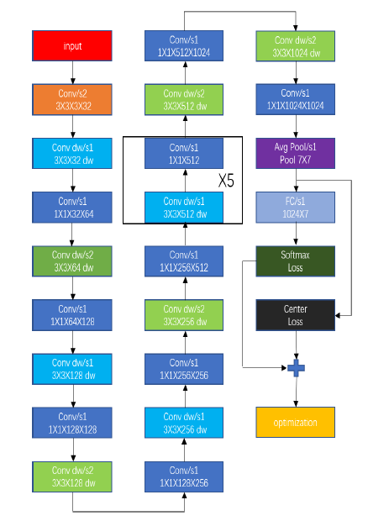
PROPOSED ARCHITECTURE WITH JOINT LOSS

Slide 28

JOINT LOSS
Center loss can be used in training step to increase discriminatory power by reducing the distance constraint between the feature and its corresponding class center. Therefore, it can be used to learn discriminative feature and improve model performance.
where xi denotes the i’th features extracted from yith class and cyi denotes the learned center for the yith class.
The softmax loss increases the distance between different classes, the center loss reduces the distance within a class. Therefore, the joint loss containing center loss and softmax loss not only enlarges inter-class feature difference, but also reduces intra-class feature variation.

Slide 29
TWO-STAGE STRATEGY
We use a two-stage approach to train the CNN model in order to deal with the problem of insufficient size of small datasets. We implement the first stage fine-tuning with FER-2013 dataset by using the model with pre-trained weights from the ILSVRC-2012 (ImageNet) . After the best trained model is obtained from the FER-2013 dataset, the second stage fine-tuning is implemented with our new dataset to obtain the final model.
Fine-tuning is the process in which parameters of a model must be adjusted very precisely in order to fit with certain observations.
For the two-stage strategy, the last fully connected layer is replaced by new fully connected layer with six facial expression classes output.

Slide 30
For the first fine-tuning stage, due to the FER-2013 dataset has 48 × 48 pixels images and the input size of original MobileNet V1 is 224 × 224 pixels, the Gaussian distribution is adopted to initialize the parameters of the first convolutional layer.
For the second fine-tuning stage, the input image of MCFER dataset has the same size of 48 × 48 pixels as the size of FER-2013 dataset after preprocessing. The weights of the first convolutional layer are initialized with the weights from the FER-2013.

Slide 31
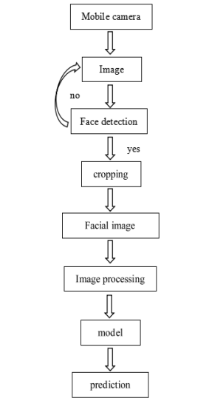
DT-FER APPLICATION
The CNN model is developed using TensorFlow platform. . In order to use CNN model on the mobile phone, the model first needs to be converted to a new data (i.e.,.lite) file by TensorFlow Lite. TensorFlow lite provides a set of tools to run TensorFlow models on mobile and embedded devices. After the model is converted to a lite file, it is deployed on mobile phone with the TensorFlow Lite interpreter.
When the app starts to work, it continuously captures the images from the front camera or rear camera. The haar-like feature is employed to detect faces in the application and then the detected faces are cropped and resized to 48 × 48 size. After normalization and other processing methods, the face images are fed into the model as input. Finally, the prediction and other results are shown on the screen in real time.

Slide 32
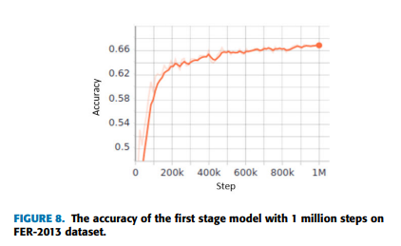
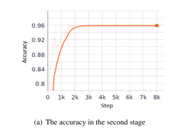
PERFORMANCE OF CNN MODEL
With 8000 training steps, the model trained on FER-2013 database in the first fine-tuning stage obtained an accuracy of 67.03%.
Based on the first stage pre-trained model on FER-2013 dataset, the accuracy of model on MCFER dataset in the second stage is about 95.89%.

Slide 33
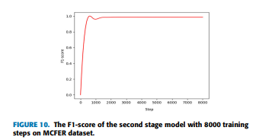

F1-score of the model is 98.79%.
We test three methods with different training stages and loss functions on two datasets, CK+ and MCFER.

Slide 34
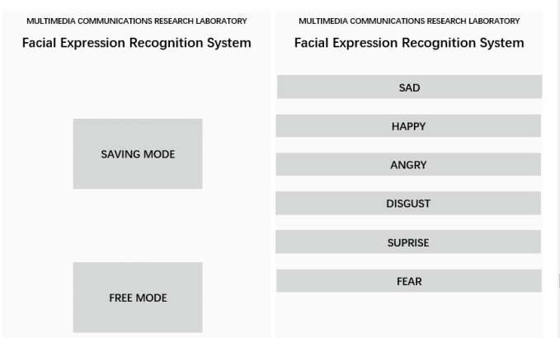
PERFORMANCE OF DT-FER APPLICATION
The application has two kinds of working modes: saving mode and free mode. The saving mode means the images and predicted results are saved on the phone, which would help carers to observe behaviors of people with autism at any time and provide better suggestions to patients, but the app would run slower because of saving image. The free mode, in turn, means nothing needs to be saved, so the app runs at higher speed compared with saving mode.

Slide 35
CONCLUSION
In this paper, we adopt a deep learning technique to process emotional big data and develop an emotion care system using facial expression recognition system working on smartphone.
The CNN model is trained with two emotional datasets:FER-2013 and a new proposed dataset, MCFER. We employ a two-stage strategy and joint supervision to train our model and test the method on two datasets: CK+ and MCFER, which shows the performance is improved.
The existing systems are compared, While most applications work in real time and offline, none of them supports multiple users for emotion detection. Therefore, multi-user Android application, Our proposed system running in real time and offline for emotion care and autism disorder patient training.
We test the application in a smartphone with two modes, saving mode that saves the predicted results to help doctors or parents monitor autism disorder patient and free mode that make the system work at high speed.

Slide 36
FUTURE SCOPE
The Proposed System has a good performance with a speed of up to 12 fps. Because of the weak computation power and limited memory for the embedded system, the model could be quantified to save memory space and improve speed in the future.
Emotion-based music player (EMOSIC) which can recognize the mood of the individual and play music accordingly. It could play a crucial role in improving a person’s mental state.
Through improvement we could make it into a system that can distinguish lies said by an individual through his/her facial expression and body language.

Slide 37
REFERENCES
M. Suk and B. Prabhakaran, ``Real-time mobile facial expression recognition system-A case study,'' in Proc. IEEE Conf. Comput. Vis. Pattern Recognit . Workshops, Jun. 2014, pp. 132-137.
I. Song, H.-J. Kim, and P. B. Jeon, ``Deep learning for real-time robust facial expression recognition on a smartphone,'' in Proc. IEEE Int. Conf. Consum. Electron. (ICCE), Jan. 2014, pp. 564-567.
G.-S. Jo, I.-H. Choi, and Y.-G. Kim, ``Robust facial expression recognition against illumination variation appeared in mobile environment,'' in Proc. 1st ACIS/JNU Int. Conf. Comput., Netw., Syst. Ind. Eng., May 2011, pp. 10-13.
H. Alshamsi, V. Kepuska, and H. Meng, ``Automated facial expression recognition app development on smart phones using cloud computing,'‘ in Proc. IEEE 8th Annu. Ubiquitous Comput., Electron. Mobile Commun. Conf. (UEMCON), Oct. 2017, pp. 577-583.
J. Li and E. Y. Lam, ``Facial expression recognition using deep neural networks,'' in Proc. IEEE Int. Conf. Imag. Syst. Techn. (IST), Sep. 2015, pp. 1-6.

Slide 38
THANK YOU

